Slide 1
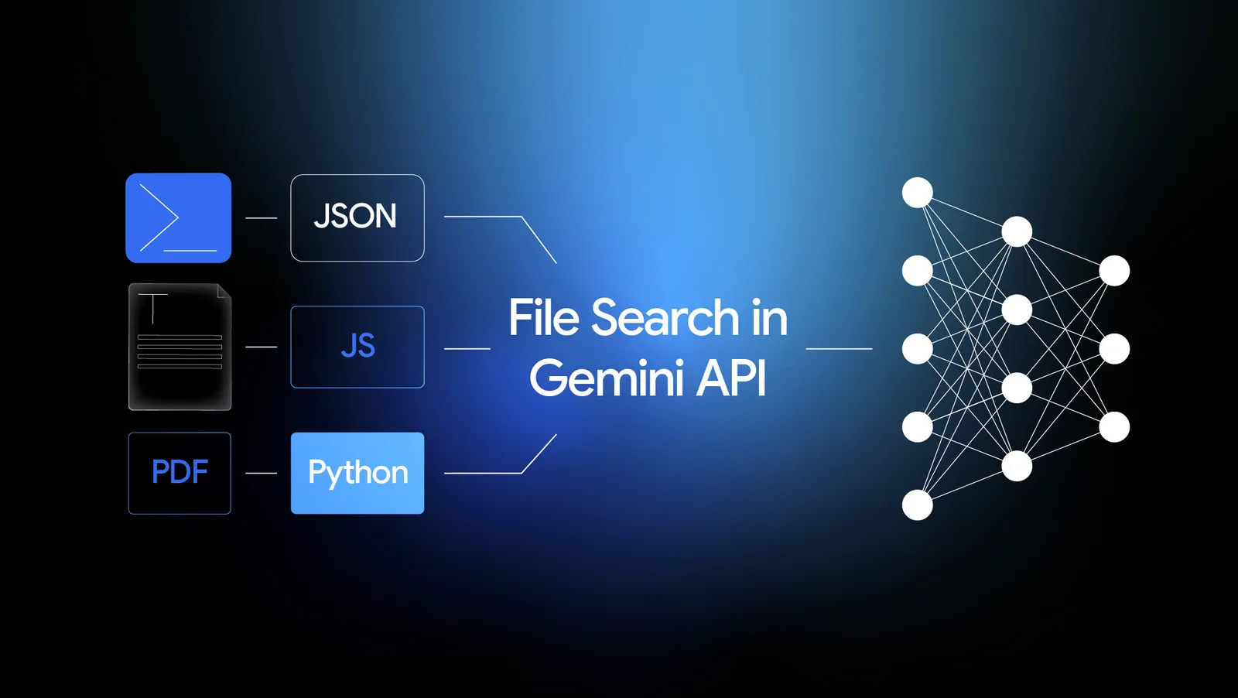
Gemini File Search (RAG)
Presented by :Ananda Rimal
Collab with freecodecamp

Slide 2
RAG
AI system
Chatgpt
Company Data
Ask
ABC
Users

Slide 3
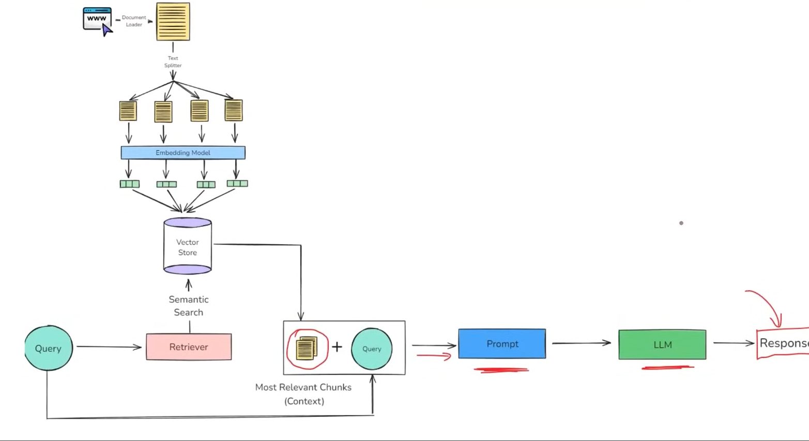
Traditional Rag

Slide 4
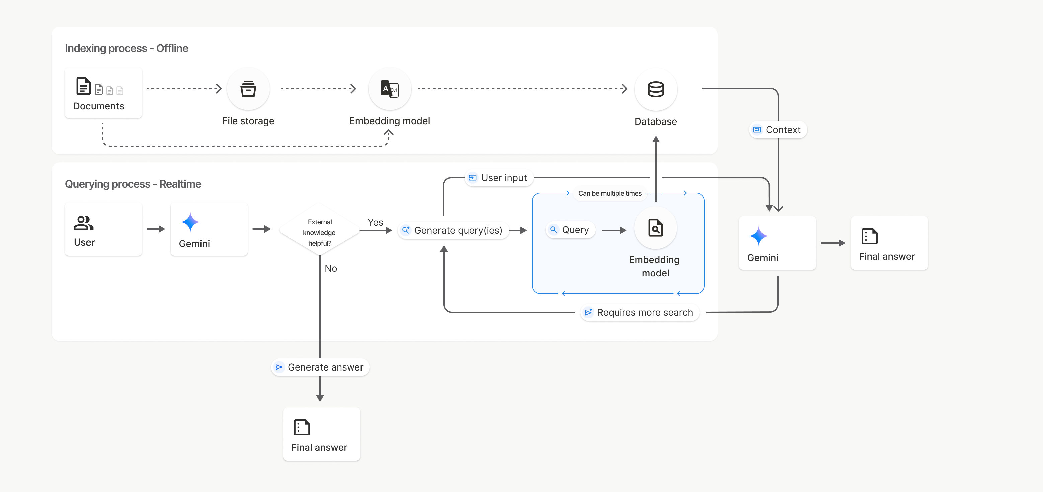

Gemini File Search Tool Architecture

Slide 5
Step1
Uplaod files through files api
You can upload multiple files
files
Step2
Vector store 1
Vector store 2
Vector store 3
Creating Vector Store
Step3
Importing files Into vector store
Indexing and chunking and storing vectors
Step4:

Slide 6
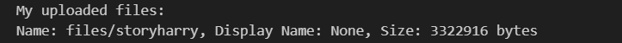
But

Slide 7
Supported models
The following models support File Search:
gemini-3-pro-preview
gemini-2.5-pro
gemini-2.5-flash and its preview versions
gemini-2.5-flash-lite and its preview versions
Rate limits
The File Search API has the following limits to enforce service stability:
Maximum file size / per document limit: 100 MB
Total size of project File Search stores (based on user tier):
  Free: 1 GB
  Tier 1: 10 GB
  Tier 2: 100 GB
  Tier 3: 1 TB

Slide 8
Pricing
Developers are charged for embeddings at indexing time based on existing embeddings pricing ($0.15 per 1M tokens).
Storage is free of charge.
Query time embeddings are free of charge.
Retrieved document tokens are charged as regular context tokens.

Slide 9
Don’t be confused — when we upload files through the Files API, we are actually providing the files for the Gemini File Search tools. All of this is handled by Google’s infrastructure.
The second step is creating a File Search store, which works as a vector store.
The third step is importing the uploaded files into the vector store, where indexing and chunking are performed automatically.

Slide 10
Business Book
Science Book
Story Book
Business Store
Science Store
Story Store
Chat with all stores
Chat with business book
Chat with science book
Chat with story book

